Slide 1

CSE 219 – Computer Science III
Event Programming
Gros Morne N.P., Newfoundland

Slide 2
Event Programming
Operating Systems constantly monitor events
  Ex: keystrokes, mouse clicks, etc…
The OS:
  sorts out these events
  reports them to the appropriate programs

Slide 3
Where do we come in?
For each control (button, combo box, etc.):
  define an event handler
  construct an instance of event handler
  tell the control who its event handler is
Event Handler?
  code with response to event
  a.k.a. event listener

Slide 4
Java’s AWT/Swing Event Handling
Event Sources and Event Listeners
An event source is a GUI control
  JButton, JComboBox, JList, JFrame, JPanel, etc.
  different types of sources:
    can detect different types of events
    can register different types of listeners (handlers)
When the user interacts with a control (source):
  an event object is constructed
  the event object is sent to all registered listener objects
  the listener object (handler) responds as you defined it to

Slide 5
Event Listeners
i.e. Event Handler
Defined by you, the application programmer
  you customize the response
  How?
    Inheritance & Polymorphism
You define your own listener class
  implement the appropriate interface
  define responses in all necessary methods

Slide 6
Event Objects
Contain information about the event
Like what?
  location of mouse click
  event source that was interacted with
  etc.
Some examples:
  ActionEvent, MouseEvent, WindowEvent, ListSelectionEvent, TreeSelectionEvent, etc.
Listeners use them to properly respond
  different methods inside a listener object can react differently to different types of interactions

Slide 7
Necessary Java Event Handling Code
Event handler definition
  class CutHandler implements ActionListener {
  public void actionPerformed(ActionEvent ae) {
  textArea.cut();
  }
  }
Construct an event handler object for your GUI
  CutHandler cutHandler = new CutHandler();
Construct your event sources
  JButton cutButton = new JButton("Cut");
  JMenuItem cutMenuItem = new JMenuItem("Cut");
Register your event handler with your sources
  cutButton.addActionListener(cutHandler);
  cutMenuItem.addActionListener(cutHandler);

Slide 8

Kinds of Source Objects
Swing Components
  JButton, JCheckbox, JPanel, etc…
  Each may produce different kinds of events

Slide 9
Kinds of Event and Listener Objects
Different event sources can produce different kinds of events
  ActionEvent (sent by JButton and other components)
  MouseEvent (sent by JPanel and other components)
Different listener objects implement different required methods from interfaces
  ActionListener - (actionPerformed)
  MouseListener - (mouseClicked, mouseEntered, mouseExited, mousePressed, mouseReleased)

Slide 10
A GUI Design Pattern
One way to organize your GUI data:
Declare all GUI controls as instance variables
Construct and arrange (layout) controls
Define an class for each type of event to be your listener
Declare one instance of each handler as instance variables
Construct your handler objects and give them what they need
Register your handlers with your GUI controls
Note: We’ll see different arrangements in the HWs

Slide 11
An Outline of our GUI Design Pattern
public class DesignPatternFrame extends JFrame
{
// DECLARE YOUR HANDLER INSTANCE VARAIBLES
// DECLARE YOUR CONTROL INSTANCE VARIABLES
// FROM CONSTRUCTOR, INIT YOUR GUI
// - CONSTRUCT EVENT HANDLER OBJECTS
// - CONSTRUCT YOUR CONTROLS
// - REGISTER YOUR LISTENERS WITH YOUR CONTROLS
// - LAYOUT YOUR COMPONENTS
// DEFINE AN INNER CLASS FOR EACH EVENT HANDLER
}

Slide 12
DesignPatternFrame
public class DesignPatternFrame extends JFrame
{
// DECLARE YOUR HANDLER INSTANCE VARAIBLES
private CutHandler cutHandler;
// DECLARE YOUR CONTROL INSTANCE VARIABLES
private JTextArea textArea;
private JButton cutButton;
private JMenuItem cutMenuItem;
// FROM CONSTRUCTOR, INIT YOUR GUI
public MyFrame()
{
…
layoutGUI();
…
}
…

Slide 13
DesignPatternFrame (continued)
// - REGISTER YOUR LISTENERS WITH YOUR CONTROLS
public void layoutGUI()
{
…
// - CONSTRUCT EVENT HANDLER OBJECTS
cutHandler = new CutHandler(textArea);
// - CONSTRUCT YOUR CONTROLS
textArea = new JTextArea();
cutButton = new JButton("Cut");
cutMenuItem = new JMenuItem("Cut");
// - REGISTER YOUR LISTENERS WITH YOUR CONTROLS
cutButton.addActionListener(cutHandler);
cutMenuItem.addActionListener(cutHandler);
// - LAYOUT YOUR COMPONENTS
…
}
…

Slide 14
DesignPatternFrame (continued)
// DEFINE AN CLASS FOR EACH EVENT HANDLER
public class CutHandler implements ActionListener
{
      private JtextArea textArea;
      public CutHandler(JTextArea initTextArea)
      {
        textArea = initTextArea;
      }
public void actionPerformed(ActionEvent ae)
{
textArea.cut();
}
}

Slide 15
ActionListener Interface
Single method in the interface
public void actionPerformed(ActionEvent e)
The ActionEvent class has methods to get information about the event
  public Object getSource()
  public String getActionCommand()
  but we don’t even care about these using our GUI design pattern

Slide 16
Event Handling Summary
Necessary code:
  Specify a class to implement a listener interface
    implements ActionListener
  Code that implements the methods of the listener interface
    public void actionPerformed(ActionEvent e) {…}
  Code that registers a listener object on an event source
    cutButton.addActionListener(this)

Slide 17
AWT Events Passed to Listeners
Semantic events
  ActionEvent – button click, menu selection, etc.
  AdjustmentEvent – scrollbar adjustment
  ItemEvent – selection from a set of checkboxes
  TextEvent – contents of a text area changed
Low-level events (inherit from ComponentEvent)
  ComponentEvent – component resized, hidden, etc.
  ContainerEvent – component added or removed
  FocusEvent – a component gets focus or loses focus
  KeyEvent – key was pressed or released
  MouseEvent – mouse button pressed, released, etc.
  WindowEvent – window activated, deactivated, etc.

Slide 18
AWT Listeners to handle Events
Listeners for Semantic events
  ActionListener
  AdjustmentListener
  ItemListener
  TextListener
Listeners for low-level events
  ComponentListener
  ContainerListener
  FocusListener
  KeyListener
  MouseListener
  MouseMotionListener
  WindowListener

Slide 19
JButton Class Hierarchy
Object
Component
Container
JComponent
Window
JPanel
AbstractButton
Frame
JFrame
JButton

Slide 20
JButton Class
An implementation of a push button
Constructors
  – button with an icon
  JButton cutButton = new JButton(
new ImageIcon("cut.gif"));
  button with text
  JButton cutButton = new JButton("Cut");
  button with an icon and text
Some methods:
  addActionListener, doClick

Slide 21
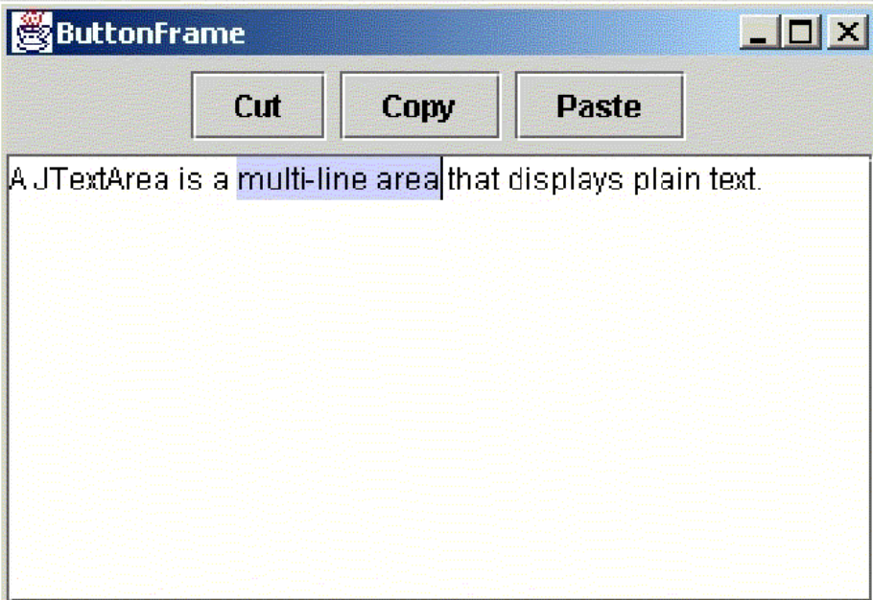
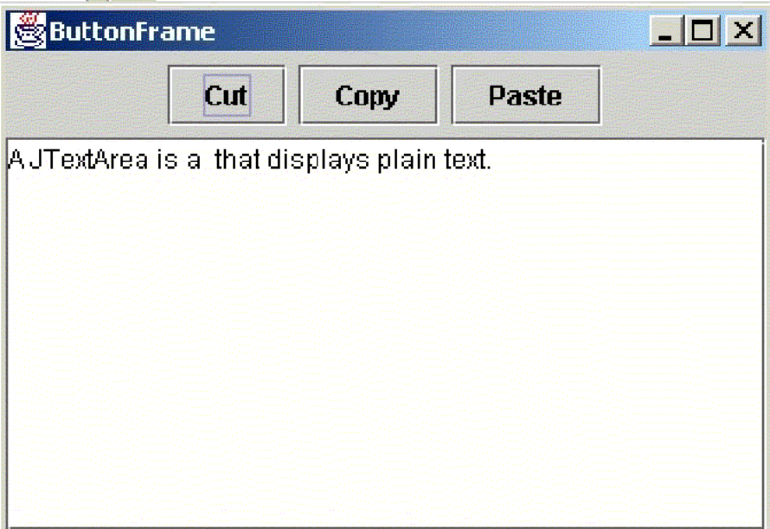
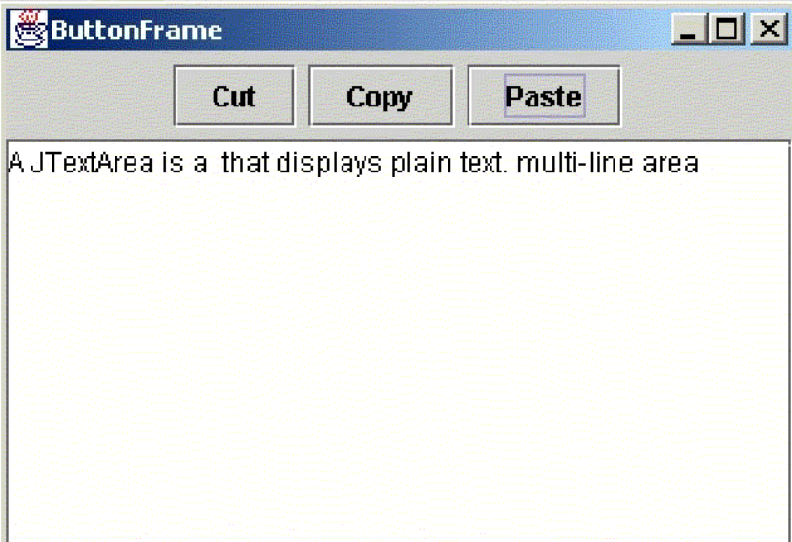
Executing the ButtonFrame program

Slide 22
Using a JFrame class as a listener
public class ButtonFrame extends JFrame
{
private CutHandler cutHandler;
private CopyHandler copyHandler;
private PasteHandler pasteHandler;
private JPanel buttonPanel;
private JButton cutButton;
private JButton copyButton;
private JButton pasteButton;
private JTextArea textArea;
private JScrollPane jsp;
public ButtonFrame()
{ super("ButtonFrame");
setDefaultCloseOperation(JFrame.EXIT_ON_CLOSE);
setSize(300, 200);
setLocation(0,0);
layoutGUI();
}

Slide 23
public void layoutGUI()
{
cutButton = new JButton("Cut");
copyButton = new JButton("Copy");
pasteButton = new JButton("Paste");
textArea = new JTextArea();
jsp = new JScrollPane(textArea);
cutHandler = new CutHandler(textArea);
copyHandler = new CopyHandler(textArea);
pasteHandler = new PasteHandler(textArea);
cutButton.addActionListener(cutHandler);
copyButton.addActionListener(copyHandler);
pasteButton.addActionListener(pasteHandler);
buttonPanel = new JPanel();
buttonPanel.add(cutButton);
buttonPanel.add(copyButton);
buttonPanel.add(pasteButton);
Container contentPane = getContentPane();
contentPane.add(buttonPanel, BorderLayout.NORTH);
contentPane.add(jsp, BorderLayout.CENTER);
}
}

Slide 24
public class CutHandler implements ActionListener
{
  private JTextArea textArea;
  public CutHandler(JTextArea initTextArea)
  {
    textArea = initTextArea;
  }
  public void actionPerformed(ActionEvent e)
{
textArea.cut();
}
}

Slide 25
public class CopyHandler implements ActionListener
{
  private JTextArea textArea;
  public CopyHandler(JTextArea initTextArea)
  {
    textArea = initTextArea;
  }
  public void actionPerformed(ActionEvent e)
{
textArea.copy();
}
}

Slide 26
public class PasteHandler implements ActionListener
{
  private JTextArea textArea;
  public PasteHandler(JTextArea initTextArea)
  {
    textArea = initTextArea;
  }
  public void actionPerformed(ActionEvent e)
{
textArea.paste();
}
}

Slide 27
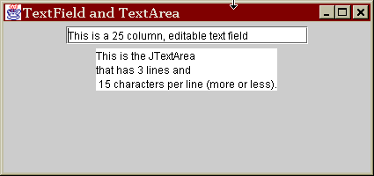

Commonly Used Swing Components
JTextField
JTextArea
JOptionPane

Slide 28
JTextField
Used to collect and display a single line of text
Label using a JLabel
Constructor
  JTextField(String text, int columns)
Some methods
  addActionListener(ActionListener a)
  getSelectedText()
  getText()
  setEditable(boolean b)
  setFont(Font f)
  setHorizontalAlignment(int alignment)
  setText(String t)
Keyboard “Enter” fires ActionEvents

Slide 29
JTextArea
Rows
Columns
Used to collect and display multiple lines of text
Constructor: textArea = new JTextArea(8, 40);
JTextAreas do not have scroll bars, so use a JScrollPane:
  JTextArea textArea = new JTextArea(8, 40);
  contentPane.add(new JScrollPane(textArea), BorderLayout.CENTER);
Other useful methods:
  append(String str)
  getText()
  insert(String str, int pos)
  setEditable(boolean b)
  setFont(Font f)
  setHorizontalAlignment
  setLineWrap(boolean b)
  setText(String t)
  setWordWrap(boolean b)

Slide 30
Option Dialogs
Swing’s set of ready-made simple dialogs.
  has an icon, a message, and one or more option buttons.
The JOptionPane class has four static methods to show these dialogs:
showMessageDialog⎯ Show a message and wait for the user to click Ok.
showConfirmDialog⎯ Show a message and get a confirmation (like Ok / Cancel).
showOptionDialog⎯ Show a message and get a user option from a set of options.
showInputDialog⎯ Show a message and get one line of user input.

Slide 31
Dialog Components
An icon (depends on message type, or supply your own icon)
  Message type can be ERROR_MESSAGE, INFORMATION_MESSAGE, WARNING_MESSAGE, QUESTION_MESSAGE, PLAIN_MESSAGE
A message, which can be any of the following:
  String: Draw the string
  Icon: Show the icon
  Component: Show the component
  Object[]: Show all objects stacked on each other
One or more option buttons

Slide 32
Further Options
Input dialog: Has an additional component for user input
  text field
  combo box
Confirm dialog: Uses four option types
  DEFAULT_OPTION
  YES_NO_OPTION
  YES_NO_CANCEL_OPTION
  OK_CANCEL_OPTION
Each of the dialogs have further options available

Slide 33
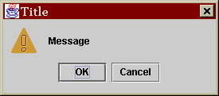
Example
int selection = JOptionPane.showConfirmDialog(parent, "Message", "Title", JOptionPane.OK_CANCEL_OPTION, JOptionPane.WARNING_MESSAGE);
if (selection == JOptionPane.OK_OPTION)
{ …

